Slide 1
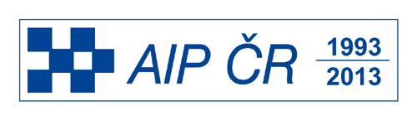
Development in TIPS RAS of novel advanced processes for conversion of gaseous feedstock and polymer wastes to value-added chemical products
INOVACE 2013

Slide 2
Innovation technologies for unconventional chemical feedstock transformation
New technology for synthesis gas production
New technology for production of olefins or gasoline from natural , associated or biogas
New technologies for synthesis gas transformation in slurry systems
Novel processes for polymer waste to fuel transformation

Slide 3
OXIDATION OF NATURAL GASES TO SYN-GAS IN REACTOR SYSTEM WITH FEEDING OF OXIDANT AND HYDROCAARBON IN DIFFERENT REACTORS
Metal oxide (MeO)
H₂ + CO
(syn-gas)
Nitrogen
Syn-gas formation reactor
ADVANTAGES OF NEW TECHNOLOGY OF SYNGAS PRODUCTION:
44 % less capital costs and 16% less syngas production costs in comparison to traditional steam reforming;
Processing of associated petroleum gas with a wide range of C2-C4 hydrocarbons and CO₂ into synthesis gas ;
Using air as an oxidant without dilution of syngas with nitrogen;
Elimination of the formation of explosive oxygen-hydrocarbon mixtures;
Low rate of catalyst deactivation due to coke removal during regeneration;
Production of considerable amounts of pure nitrogen
Regenerator
Natural or associated
gas,
Biogas
Metal (Me)
Air
Conversion hydrocarbons in syn-gas:
C_{n}H_{m} + nMeO → nCO + ½m H₂ + nMe
CO₂+CH₄ = 2CO+2H₂
Catalyst regeneration:
O2 + 2Me⁰ → 2MeO

Slide 4
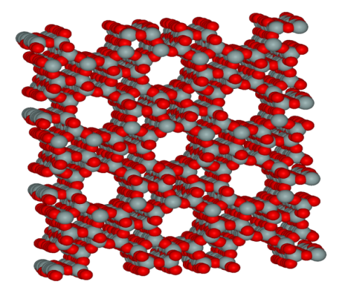
DIAGRAM OF OLEFINS (ETHYLENE AND PROPYLENE) SYNTHESYS TIPS RAS
NATURAL GAS
NEW NANOSTRUCTURATED CATSLYST
BASED ON ZSM-5
Me^{n+}
Me^{n+}
0,5-0,7 ть
SYNGAS
Me^{n+}
Catalyst production on
Industrial scale
Olefins production
PROPYLENE (TILL 60%)
DME synthesis
ETHYLENE (TILL 40 %)
The 2600 м³ of natural or associated gas gives 1 t of olefins
Gasoline or naphtha production
The yield of gasoline is 40- 50000 t per 1 mln. m³ of gas.
Notes:
4

Slide 5
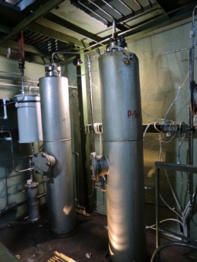
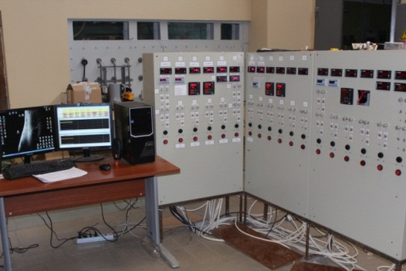
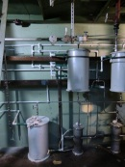
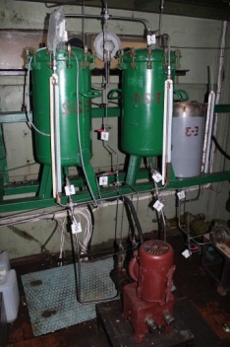
DESIGN OF PILOT PLAN

Slide 6
Process | Conversion | Olefin esynthesis |  |  | С2-С4 olefins, % | Selectivity
 |  | Катали-затор | Т,^{о}С | % |  | С2= | С3=
Пиролиз | 70 | - | 1000 | >99 | 47 | 31 | 17
Mobil | 50-70 | ZSM-5 | 350-400 | 47-75 | 26-56 | 7-24 | 20-28
UOP/Norsk-hydro | 70 | SAPO-34 | 450 | До 100 | 75-90 | 38-50 | 32-36
Lurgi (DME) | 70 | ZSM-5 | 430-450 | 99 | >69 | 0 | 70
Van Dijk (DME) | - | SAPO-34 | 450 | 70 | 49 | 70 | 0
DME TIPS | >80 | ZSM-5 | 340-450 | 95-100 | 80-88 | 30-50 | 20-47

Slide 7

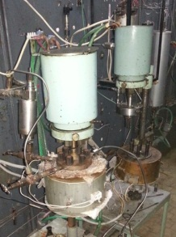
THREE-PHASE SYSTEM SLURRY TECHNOLOGY
Catalysis in three-phase systems
(slurry technologies)
Combination of homogeneous and heterogeneous catalysis advantages
+ Heat and mass transfer from the catalyst grain by the liquid medium
+Use of undiluted feed
DME production
Conversion СО: 30-56% mass.
Selectivity on DME: 91% mass.
DME in product : 95%
Catalyst productivity
– 0,14-0,67 kg/kg(kat)*h
.
Olefins production
DME conversion : 73% mass.
Selectivity on C₂-C₆: >80% mass.
Ethylene + Propylene : 95%

Slide 8
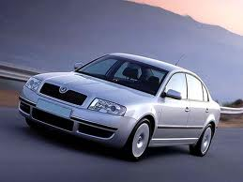
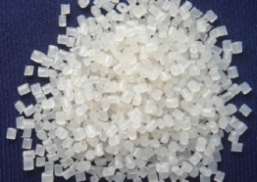
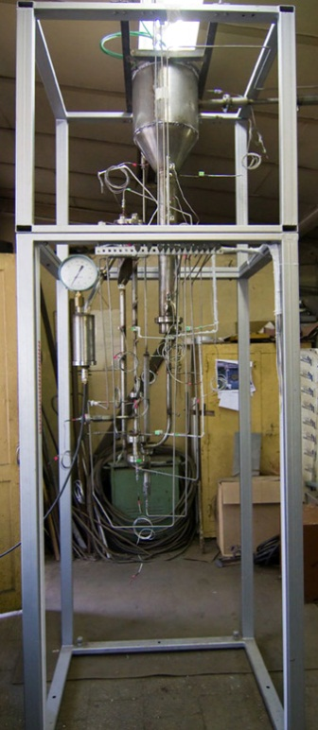
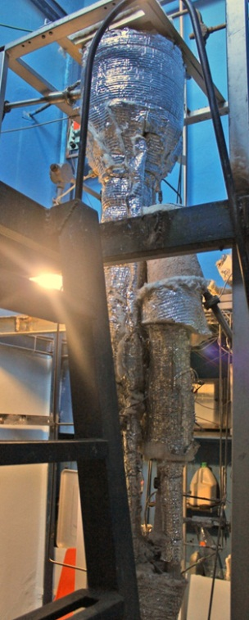
Polymer wastes for production of motor fuels and petrochemical feedstock
Oil fractions
Motor fuels
Mixing (dissolution)
Dissolved (solubilized) wastes
Catalytic cracking
Polymer wastes
Feedstock for petrochemistry
Polymers and polymer wastes:
Polyethylene (PE);
Polypropylene (PP);
Polystyrene (PS);
Poly(ethylene terephthalate)
Oil fractions:
Light gas oil;
Heavy gas oil;
Vacuum distillate
MAIN ADVANTAGES
- Surplus production of motor fuels and petrochemical products;
- Relatively low capital costs due to potential of application of the technology at existing catalytic cracking units

